Slide 1
CS 5800 : Final Project
Beyond Borders : Your Student Experience Abroad
Akshat Khare, Kirti Kshirsagar, Krina Devani & Sarthak Kagliwal

Slide 2
Table of Contents
Problem Definition
Approach
Real World Use Case
Implementation overview
Conclusion

Slide 3
Beyond Borders: Maximizing Your Student Experience Abroad
As international students studying abroad, we encounter complex challenges in navigating unfamiliar cities.
The shortest path problem is crucial for route planning, and Dijkstra's algorithm emerges as a powerful solution.
However, real-world travel optimization involves additional factors like public transportation, time, and cost.
Our objective is to leverage Dijkstra's algorithm to find optimal routes between key locations, ensuring efficient day-to-day life while studying abroad.

Slide 4
Approach
We employ a greedy algorithm to calculate optimal itineraries, incorporating all essential destinations within a day.
Destinations are represented as vertices (V) and roads as edges (E), weighted proportionally to their factors.
Dijkstra's algorithm serves as our core approach, efficiently finding shortest paths in the graph.
The priority queue's importance is emphasized for quick node selection, reducing redundant calculations and enhancing efficiency.

Slide 5
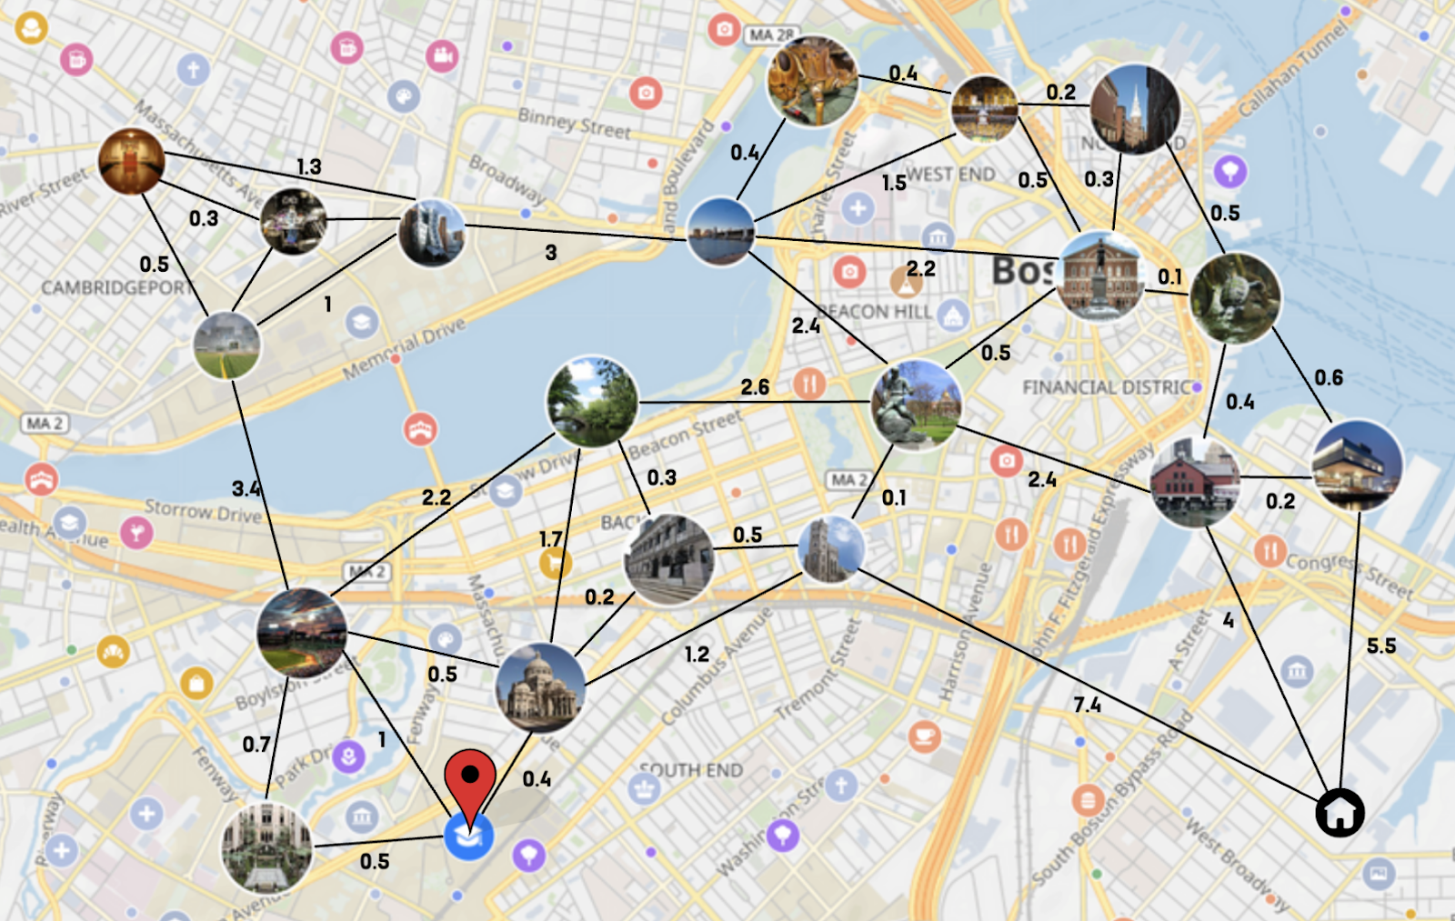
Real World Use Case:
We have used boston city for a real world example for our algorithm.
The nodes of the graph represent various destination points and the edges represent the weights between two node points.

Slide 6

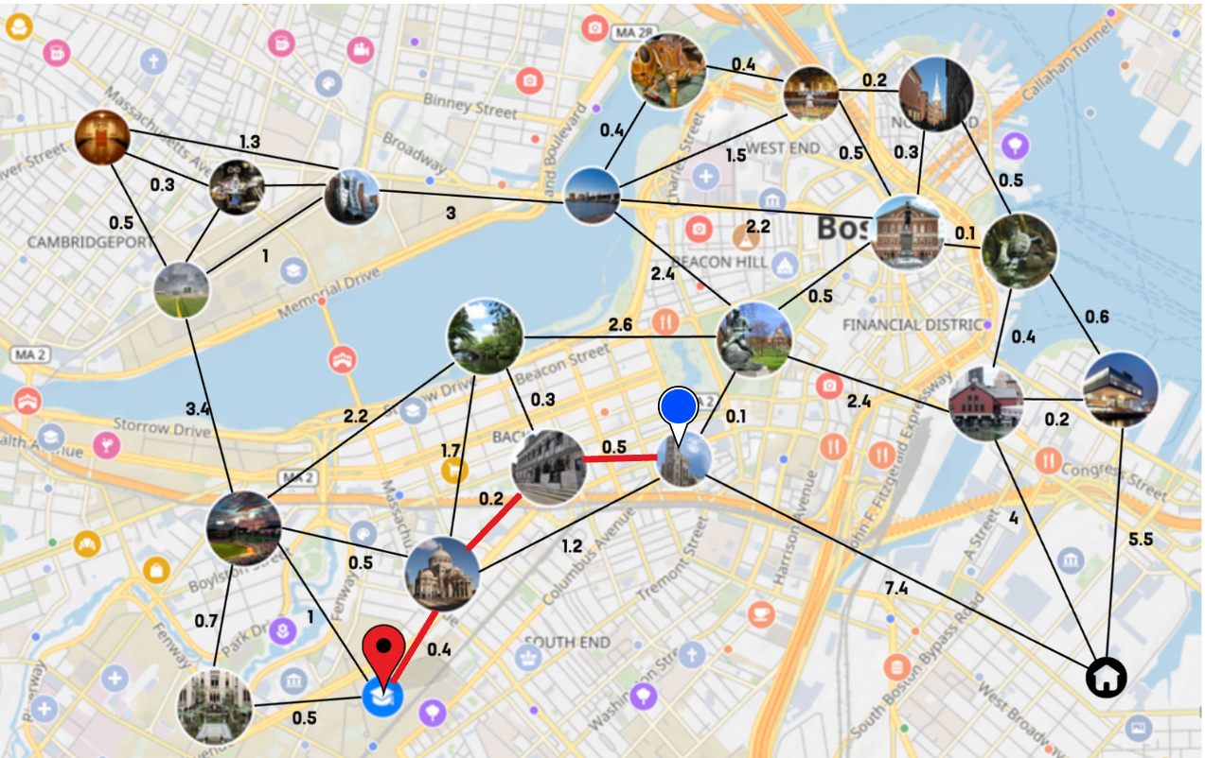
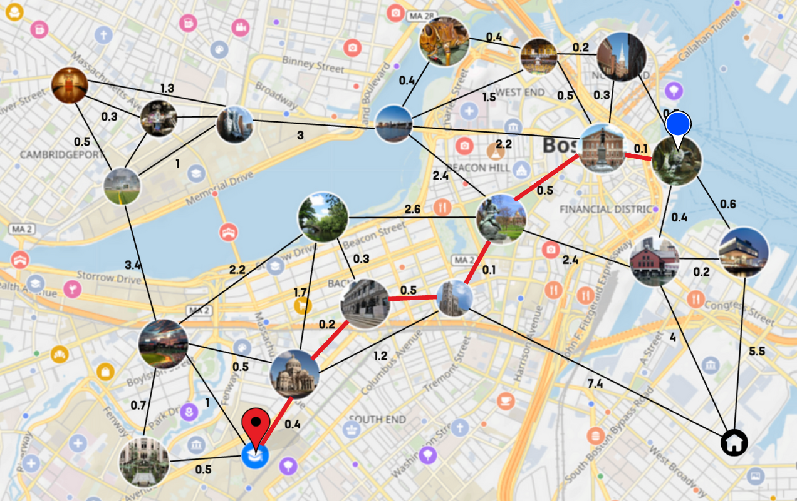
Result and Analysis
First image depicts thats our algorithm creates a graph considering all the destination points we want to visit.
Second Image shows visualization of the algorithm output, with the shortest path from source to destination.

Slide 7
Implementation Overview
We created a Graph class to represent locations as vertices and distances as edges.
Methods like addEdge and getShortestPath facilitate efficient pathfinding in the graph.
By using Dijkstra's algorithm, we construct the shortest path tree, finding the optimal route from the source (university) to the destination (home).

Slide 8
Implementation Details
Classes and Methods
The Graph class is designed to represent locations as vertices and distances as edges in the form of an adjacency map.
The addEdge method is customized to add edges between source and destination locations with their corresponding weights.
The getShortestPath method is tailored to calculate the shortest path using Dijkstra's algorithm, efficiently finding optimal routes.
Customization
To improve efficiency, we utilize a priority queue with a comparator based on distances, ensuring faster node selection.
We initialize distance values for locations using a HashMap to keep track of the shortest known distances.
A previousNodes map helps construct the shortest path tree by recording the previous node for each location.
The final implementation produces a list of locations representing the optimal route from the source to the destination.

Slide 9
Conclusion
The "Beyond Borders" project successfully applies Dijkstra's algorithm to optimize travel routes for international students.
Real-world relevance and algorithmic efficiency are demonstrated, enhancing the student experience abroad.
Practical implementation of theoretical concepts enriches our understanding and problem-solving capabilities.
By leveraging Dijkstra's algorithm, we navigate foreign cities efficiently, making the most of our study abroad journey.

